Slide 1
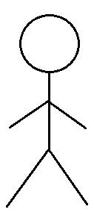
TROX: Data Flow Diagram for User’s Account
Customer Support
user-information
Account Authentication/
Authorisation
user-data
browse/ search products
credentials
User
user-data
user-information
Account Summary

